Slide 1
Diabetes Predication - SQL
PSYLIQ INTERNSHIP PROJECT
SHAMIL P
shamilp619@gmail.com

Slide 2


INTRODUCTION
Welcome to Diabetes Predication Project!
This is an SQL project focused on exploring 19 questions and executing SQL queries.
I analyzed a dataset of over 100,000 rows using MySQL, extracting crucial insights to improve understanding of healthcare data.

Slide 3

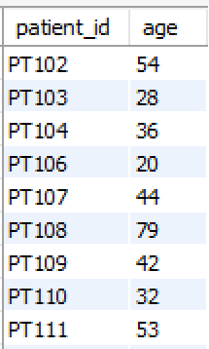
1. Retrieve the Patient_id and ages of all patients.

Slide 4
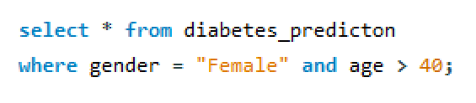
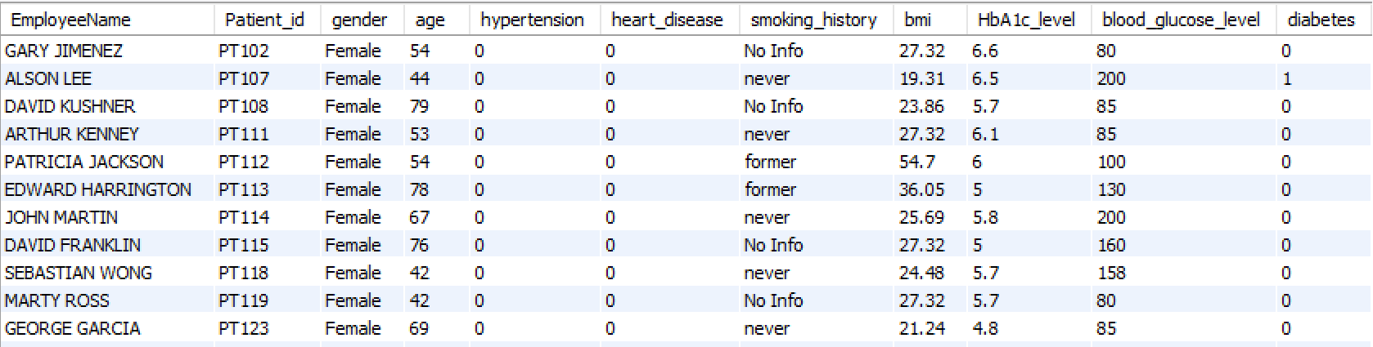
2. Select all female patients who are older than 40.

Slide 5
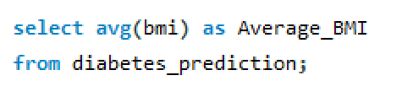

3. Calculate the average BMI of patients.

Slide 6
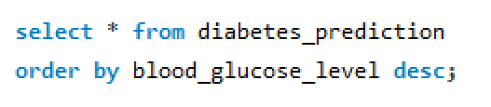
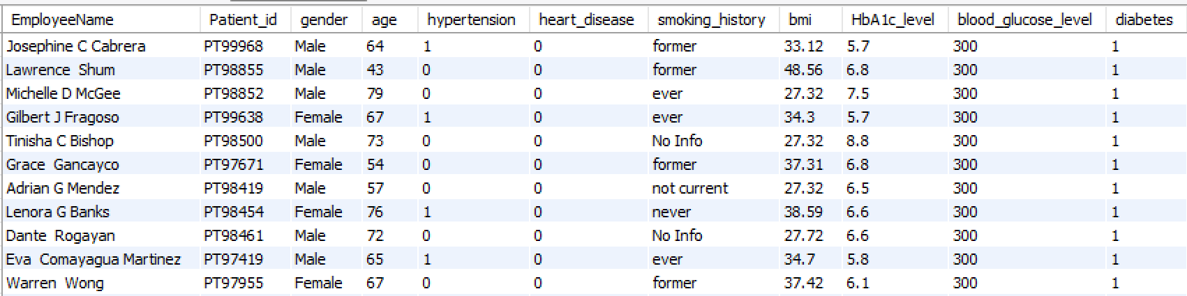
4. List patients in descending order of blood glucose levels.

Slide 7
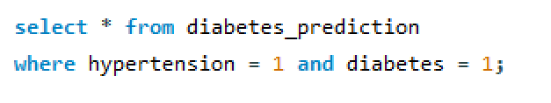
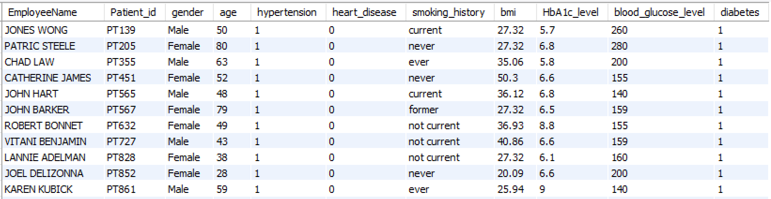
5. Find patients who have hypertension and diabetes

Slide 8

6. Determine the number of patients with heart disease.

Slide 9
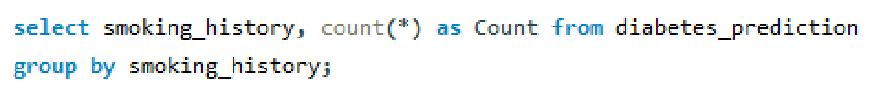
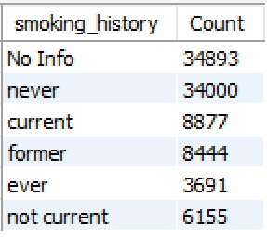
7. Group patients by smoking history and count how many smokers and nonsmokers there are.

Slide 10
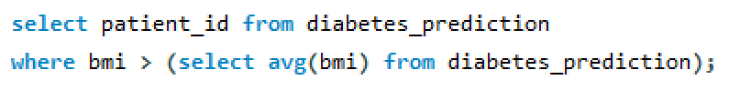
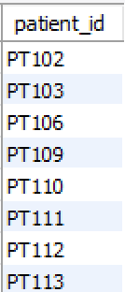
8. Retrieve the Patient_ids of patients who have a BMI greater than the average BMI.

Slide 11
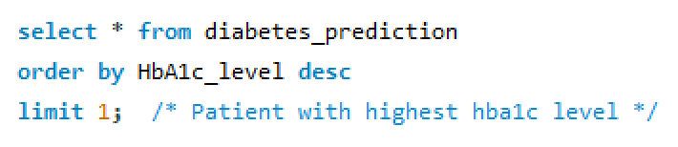
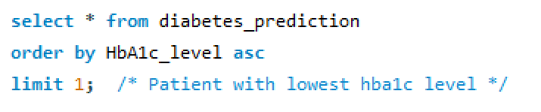
9. Find the patient with the highest HbA1c level and the patient with the lowest HbA1clevel.

Slide 12

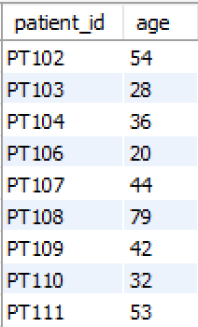
10. Calculate the age of patients in years (assuming the current date as of now).

Slide 13
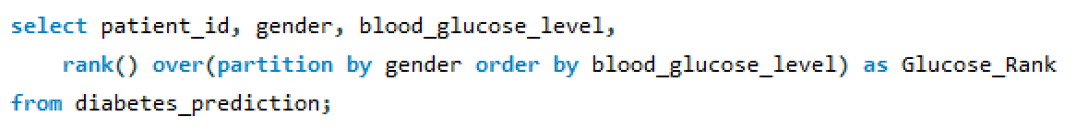
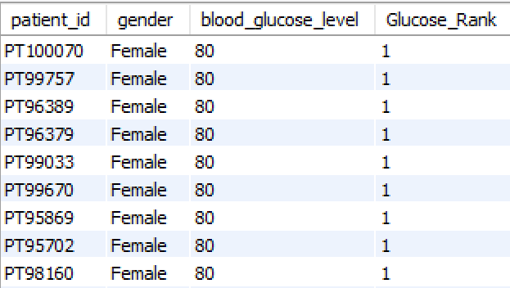
11. Rank patients by blood glucose level within each gender group

Slide 14
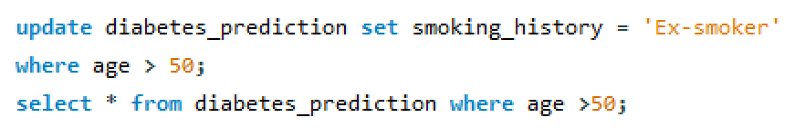
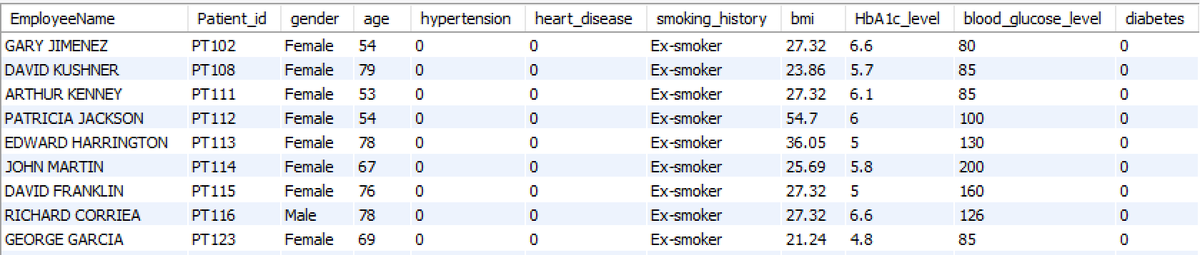
12. Update the smoking history of patients who are older than 50 to "Ex-smoker."

Slide 15
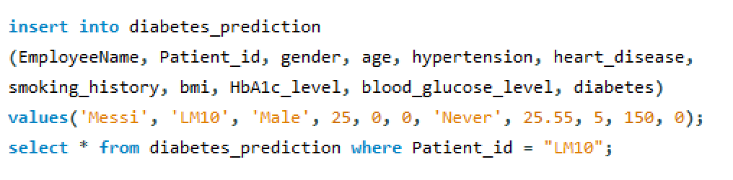
13. Insert a new patient into the database with sample data

Slide 16
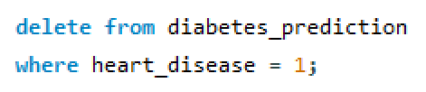
14. Delete all patients with heart disease from the database.

Slide 17
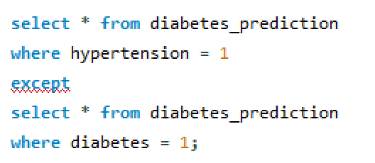
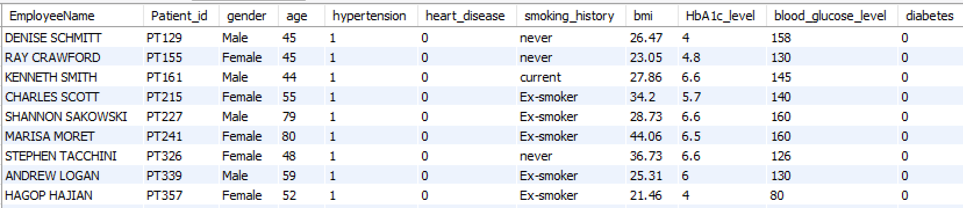
15. Find patients who have hypertension but not diabetes using the EXCEPT operator.

Slide 18
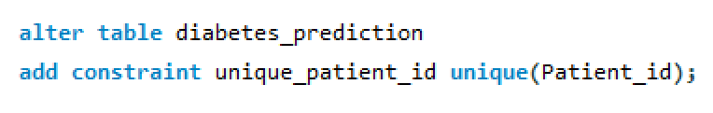
16. Define a unique constraint on the "patient_id" column to ensure its values are unique.

Slide 19
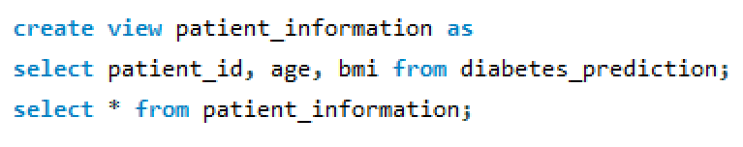
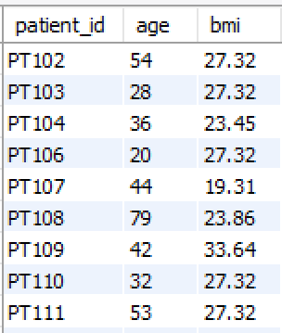
17. Create a view that displays the Patient_ids, ages, and BMI of patients.

Slide 20
18. Suggest improvements in the database schema to reduce data redundancy and improve data integrity.
Break down large tables into smaller, more manageable ones to eliminate redundant data.
Consider creating separate tables for basic patient information such as patient_id, Employee name, age and gender to avoid duplication of patient details in multiple tables.
Consider creating a table specifically for tracking patient health conditions.
Use the patient_id as primary key in this table and reference it as a foreign key in other relevant tables.

Slide 21
19. Explain how you can optimize the performance of SQL queries on this dataset.
Identify columns frequently used in WHERE clauses or join conditions and create indexes on those columns to speed up data retrieval.
Consider breaking down large queries into smaller, more manageable ones.
Use the LIMIT clause to restrict the number of rows returned, especially when dealing with large datasets.

Slide 22
INSIGHTS
Patient Demographics: The project provided valuable insights into the demographics of patients, including their ages and genders.
Health Conditions Analysis: By ranking patients based on blood glucose levels and identifying those with hypertension, diabetes, and heart disease, the project offers insights into the prevalence and coexistence of various health conditions.
HbA1c Levels: Identifying patients with the highest and lowest HbA1c levels provides insights into glycemic control within the population.
BMI Trends: Calculating the average BMI and retrieving patients with a BMI greater than the average allows for the analysis of body mass trends within the patient population.
Data Integrity Measures: Implementing unique constraints on the "patient_id" column enhances data integrity by preventing duplicate entries.

Slide 23

Thank you
SHAMIL P
shamilp619@gmail.com
23

